Slide 1
Office 365 Development

Slide 2



Recap
Introduction to Office 365 development
Module 1: Introduction to Office 365 development
Module 2: Getting started with Apps for Office
Module 3: Getting started with Apps for SharePoint
Module 4: Moving Full Trust Code to the Cloud Using Repeatable Patterns and Best Practices
Module 5: Getting started with the Office 365 APIs
dev.office.com/training

Slide 3
Course Agenda
Deep Dive into Integrating Office 365 APIs with Web Applications
Module 1: Deep Dive into Azure AD with the Office 365 APIs
Module 2: Deep Dive into Office 365 APIs for Calendar, Mail, and Contacts
Module 3: Deep Dive into Office 365 APIs for OneDrive for Business
Module 4: Deep Dive into Office 365 APIs for SharePoint Site services
Module 5: Deep Dive into Office 365 APIs for Yammer services
Module 6: Deep Dive into Office 365 APIs for Office Graph
Module 7: Deep Dive into Office 365 APIs for OneNote services

Slide 4
Deep Dive into Office 365 APIs for OneDrive for Business

Slide 5

Agenda
Overview
File Operations with SharePointClient
File Operations with REST

Slide 6
Developer vision
USERS
DATA
HTML

Slide 7
Overview

Slide 8
Which to use?
OneDrive
Accessible cloud storage for personal documents, photos, and files that can be accessed from anywhere.
Best for user owned content.
OneDrive for Business
Secure enterprise grade storage for business documents and files.
Best for business / enterprise owned content.
Depending on your app targeting both is appropriate.

Slide 9
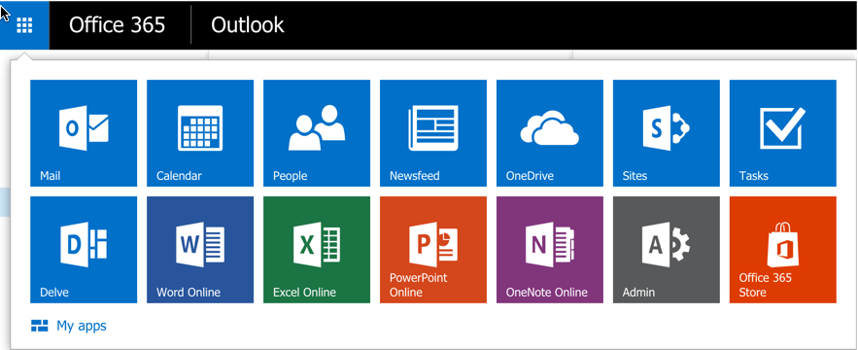
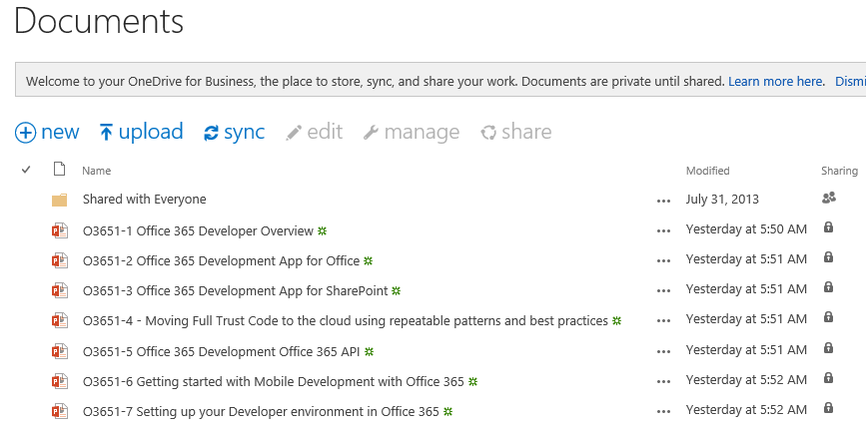
OneDrive for Business
A personal library for storing and organizing your work documents
Notes:
OneDrive for Business is a personal library intended for storing and organizing your work documents. As an integral part of Office 365 or SharePoint Server 2013, OneDrive for Business lets you work within the context of your organization, with features such as direct access to your organization’s address book.
Note OneDrive for Business is different from OneDrive, which is intended for personal storage separate from your workplace. OneDrive for Business is also different from your team site, which is intended for storing team or project-related documents.

Slide 10
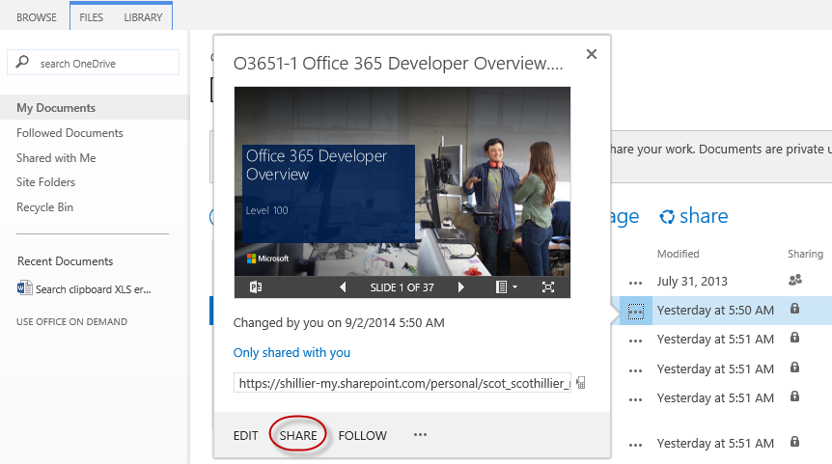
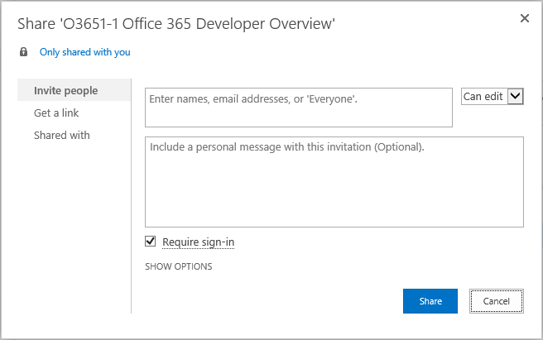
OneDrive for Business Sharing
Notes:
The documents and folders you store in OneDrive for Business are private until you decide to share them. When you share documents and folders, you can decide whether to let people edit them, or just view them. You can also share documents or folders in a site library.
Note If you’re using Office 365, you may be able share documents with external users (people not on your network) by inviting them as “Guests,” or by creating and posting guest links

Slide 11
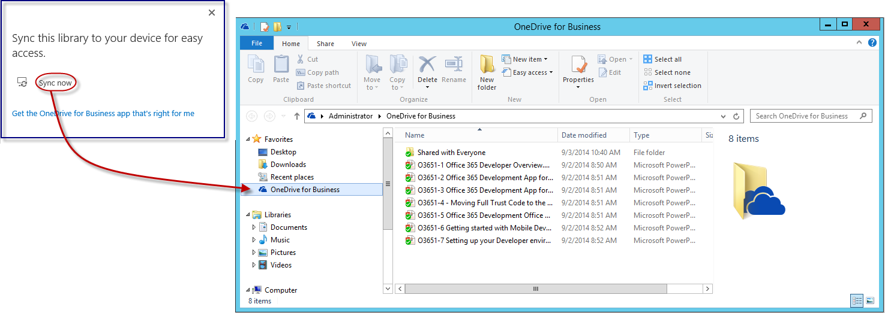
OneDrive for Business Sync
Notes:
The OneDrive for Business sync app lets you synchronize your OneDrive for Business library or other SharePoint site libraries to your local computer. This sync app is available with Office 2013 or with Office 365 subscriptions that include Office 2013 applications. If you don’t have Office 2013, a free download of the OneDrive for Business sync app is also available.
To sync OneDrive for Business, sign in to Office 365 or SharePoint, select OneDrive at the top of the page, and then click Sync.
You’ll find your synchronized files in your File Explorer, under Favorites. If you’re syncing an Office 365 OneDrive for Business library, your synchronized files appear in the OneDrive@<organization> folder. Work on them locally if you like and your changes will be synchronized automatically with your OneDrive for Business library when you’re online.

Slide 12
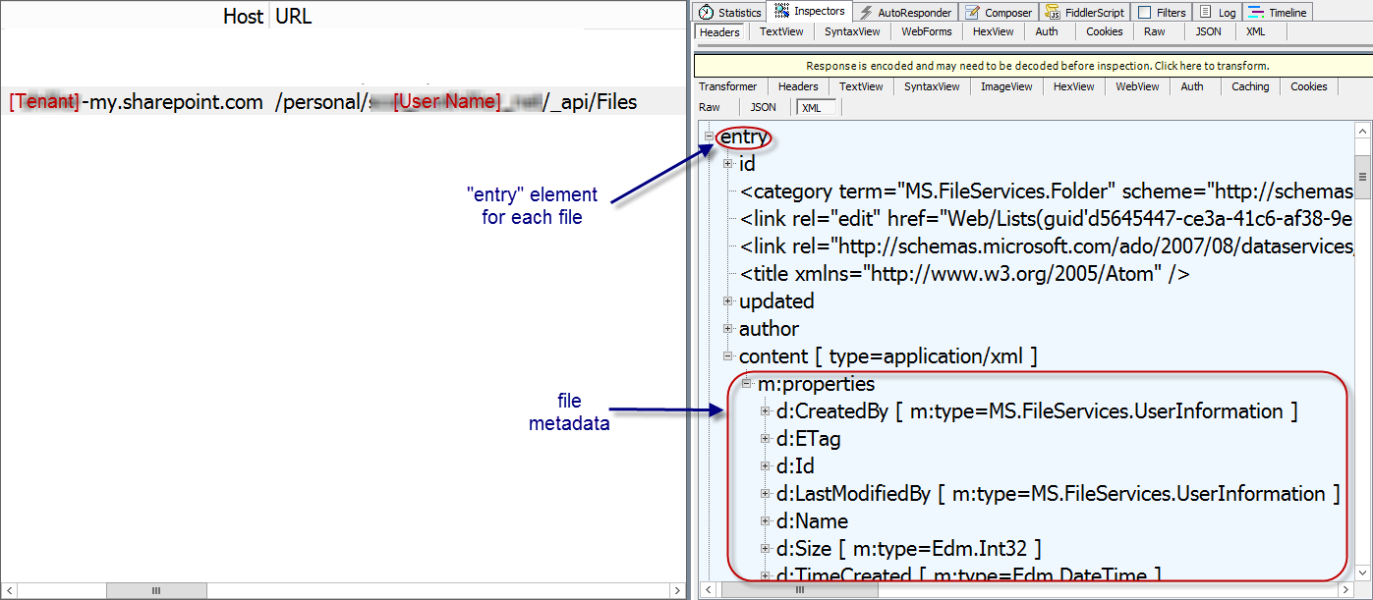
The Files API
https://[site]/_api/Files
Notes:
_api/Files always targets the “Documents” library in a SharePoint site
For personal sites, this is the OneDrive for Business library

Slide 13
Navigating Items Your Way
Use the colon to denote a path within the drive
/drive/root:/Contoso/ProjectA:/children
/drive/items/F0A1291828!101/children
Combine ID and Path
/drive/items/F0A..19:/document1.docx
Address entities on items
/drive/items/F0A..19/thumbnails/0/large

Slide 14
Sync Changes
Callable on any folder, not just the root
Based on a sync token, returns items changed since token was generated
Deleted items are returned with ‘deleted’ property
Moving an item out of the hierarchy will make you resync

Slide 15
App Folders
A home for content created in your app
Keep your app files in a known location
No need to create folders
Restricted access to only your folder makes your app more trustworthy

Slide 16
Large Files
Upload up to 10 GB using this method
/upload.createSession
Provide the details of the file you are uploading
If the file is available on the internet, use Upload From URL instead
PUT fragments until complete
Create and upload requests with sequential fragments of the file until the whole file is uploaded
When the last fragment is received, the file is added to the user’s OneDrive

Slide 17
File Operations with SharePointClient

Slide 18
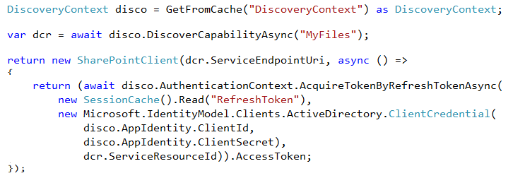
SharePointClient class
Discovery Service discovers “MyFiles” capability
Returns tenant and user-specific URL for user’s OneDrive for Business
SharePointClient.Files abstracts Files API
Notes:
The discovery service discovers the “MyFiles” capability, which will always try to access the OneDrive for Business library

Slide 19
Reading File Metadata
Read Files collection
Can also read an individual Folder
Notes:
No support for $skip and $orderby so paging is post-query

Slide 20

Uploading a new File
Use AddAsync method
Provide a file name and the file stream

Slide 21
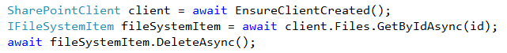
Deleting a File
Get the target file using GetByAsync method
Delete using DeleteAsync method

Slide 22
demo
File operations with the SharePointClient

Slide 23
File Operations with REST

Slide 24
OneDrive for Business Files REST API
Get the metadata for all files in OneDrive
GET http://<onedrive>/_api/Files
Get the metadata for a folder in OneDrive
GET http://<onedrive>/_api/Files('folder')
Get the metadata for the children of a folder in OneDrive
GET http://<onedrive>/_api/Files('folder')/Children
Get the metadata for a single file in OneDrive
GET http://<onedrive>/_api/Files('folder/filename.docx')
Download a single file from OneDrive
GET http://<onedrive>/_api/Files('folder/filename.docx')/download

Slide 25
OneDrive for Business Files REST API
Upload a file to the specified path in OneDrive (pass file in body)
POST /_api/Files/Add(name='folder/filename.docx',overwrite=<bool>)
Delete a file from OneDrive
DELETE /_api/Files('folder/filename.docx')
Get metadata for a folder and its children
GET /_api/Files('folder')?$expand=Children
Get on selected metadata fields back for first 5 files in OneDrive
GET /_api/Files?$select=Name,Id,TimeCreated,Size&$top=5
Use Files API on other document libraries
GET /_api/Lists/GetByTitle('ListTitle')/Files

Slide 26
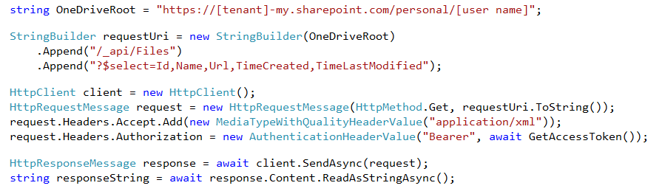
Reading File Metadata
GET Files endpoint
Notes:
Note that the OneDrive URI is hard-coded just for clarity. Normally, you would get this from the discover service.
Paging is implemented using a $skipToken parameter on the query

Slide 27
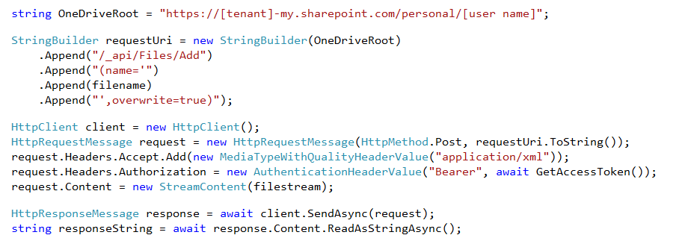
Uploading a new File
POST to Add endpoint
Provide a file name and the file stream
Notes:
Note that the OneDrive URI is hard-coded just for clarity. Normally, you would get this from the discover service.

Slide 28
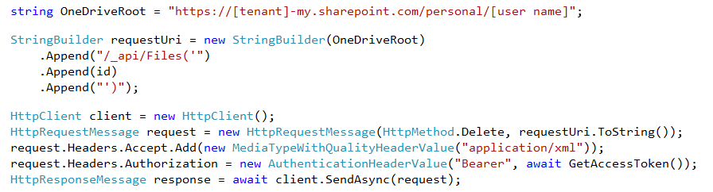
Deleting a File
DELETE the target file ID
Notes:
Note that the OneDrive URI is hard-coded just for clarity. Normally, you would get this from the discover service.

Slide 29
demo
File Operations with REST

Slide 30
OneDrive API for OneDrive for Business
Key differences
Authentication: Need to target AAD or MSA depending on user type. Auth scopes are different as a result
Discovery: OneDrive for Business doesn’t have a common API end point, so discovery API is still necessary
Similarities
Once your app has an access token, code should be the same (see release notes for full details).

Slide 31
Related Code Samples
OneDrive API Explorer (JavaScript)
http://github.com/OneDrive/onedrive-explorer-js
OneDrive API Explorer (Windows / C#)
http://github.com/OneDrive/onedrive-explorer-win
Picker & Saver for JavaScript
https://dev.onedrive.com/sdk/javascript-picker-saver.htm

Slide 32
Related Documentation
Office Dev – Office 365 Files REST API Reference
https://msdn.microsoft.com/office/office365/APi/files-rest-operations
OneDrive Dev Center
https://dev.onedrive.com/

Slide 33
Summary
Overview
File Operations with SharePointClient
File Operations with REST

Slide 34
Developer Program Launch
1 YEAR FREE
E-mail Newsletters
Free Developer Subscription
Free Training
Free Tools
Webinars
http://dev.office.com/devprogram

Slide 35


Engage
Office 365 Network
https://www.yammer.com/itpronetwork
Twitter
S
S
t
t
a
a
r
r
t
t
@OfficeDev
Stack overflow
[ms-office]
Channel 9 Dev Show
http://aka.ms/O365DevShow
Podcasts http://dev.office.com/podcasts
Snack Demos
http://aka.ms/o365DevSnackDemos
UserVoice
http://officespdev.uservoice.com/

